Slide 1

PAYSURE
PRESENTED BY GROUP 22

Slide 2





Meet The Team
TAAHIR ​
KOLIA
ALKA​
SEWRAJ
MORRIS​
NKOMO
MULISA​
MATODZI
NEIL ​
SMIT

Slide 3

Let's Meet
Anil

Slide 4
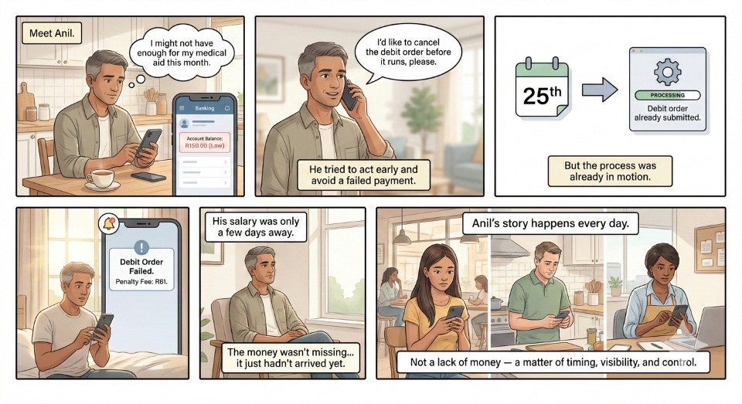

Slide 5

Problem Statement
Hidden Failure in Everyday Banking

Slide 6
The Hidden Cause of Debit Order Failures ​
Assumption:
Debit order failures = insufficient funds
Reality:
Many failures are caused by structural timing frictions:
Settlement delays
Cut-off times
Customers may appear liquid , yet transactions fail.
Impact:
Penalty fees and Service interruptions
Trust erosion
Essential obligations (insurance, loans) are disproportionately affected.

Slide 7
Two Risks, One Blunt Response ​
Today, two very different scenarios are treated the same:
Risk Type | Description | Triggers / Outcomes
Payment Orchestration Risk | Funds exist, but timing causes failure | Low-balance alerts Generic credit visibility Post-failure explanations
Short-Duration Liquidity Risk | Funds genuinely unavailable within a narrow window
7

Slide 8
The Missing Layer
The Gap
There is no integrated layer that:
Interprets shortfall context
Differentiates timing vs liquidity risk
Matches risk type to proportionate action
Provides pre-failure clarity
Predictive Systems
Credit Infrastructure
Nav»Money
Cashflow forecasting
Shortfall alerts
Overdrafts
Temporary facilities
Loan products
Prediction exists. Credit exists. Contextual decision intelligence does not.

Slide 9
Research and Findings

Slide 10
QUANTIFYING THE PROBLEM AND ITS IMPACT
To better understand customers’ sentiment around debit order interactions, and quantify how these experiences influence overall satisfaction, we conducted a survey that captured 29 responses from non-FNB channels.
The purpose of the survey was to validate whether the challenges we’ve identified have a meaningful effect on customers and to gain insight into where pain points and opportunities for improvement truly lie.

Slide 11
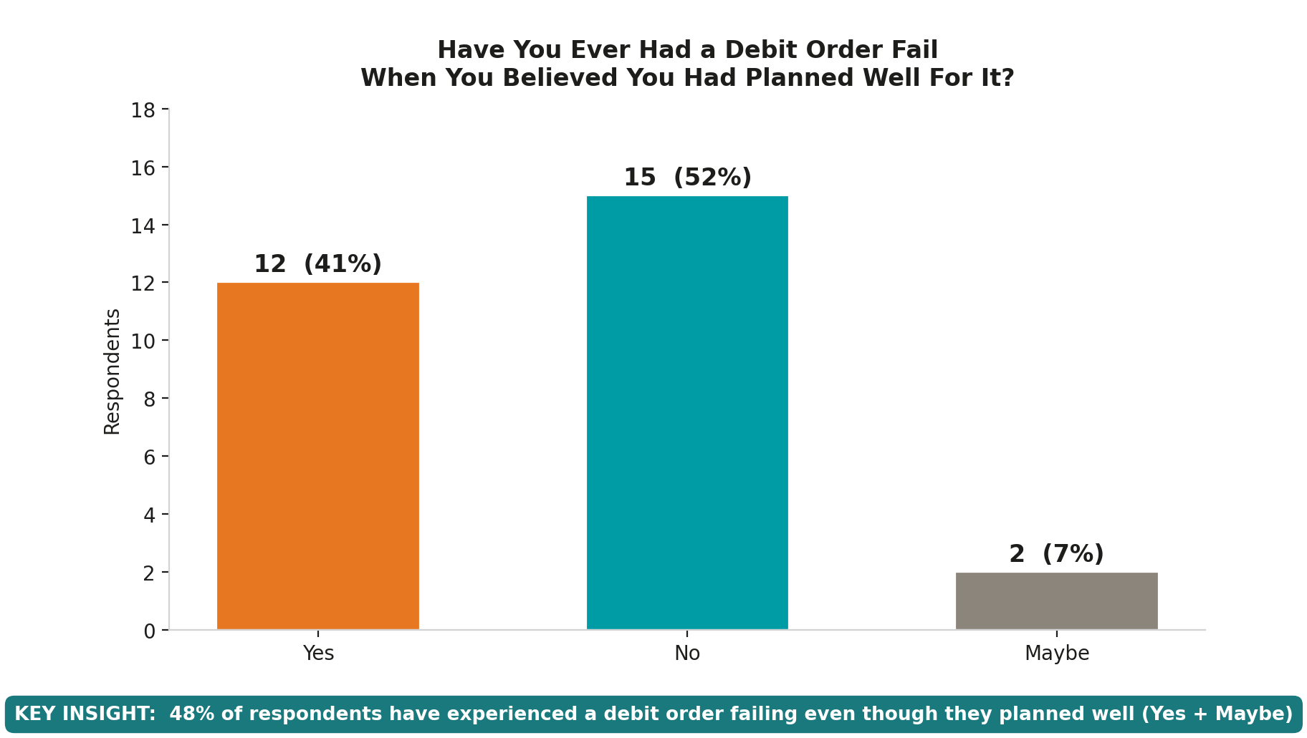

Prevalence of Debit order Failures

Slide 12
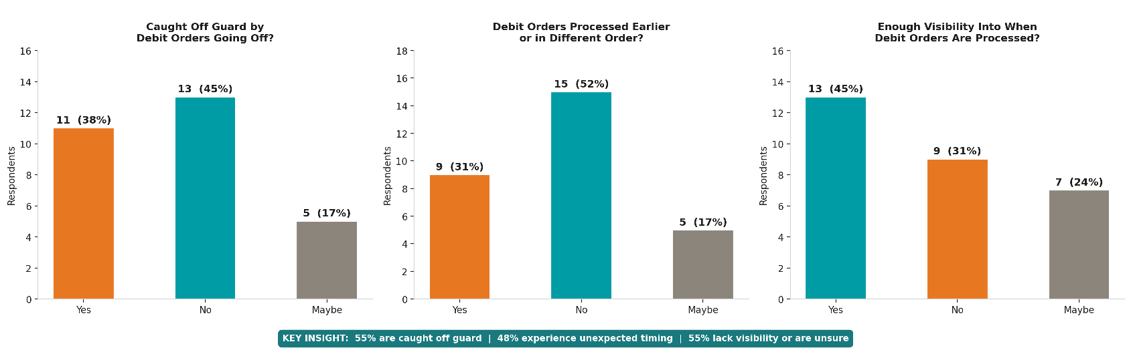
Timing Issues and Visibility Gap

Slide 13
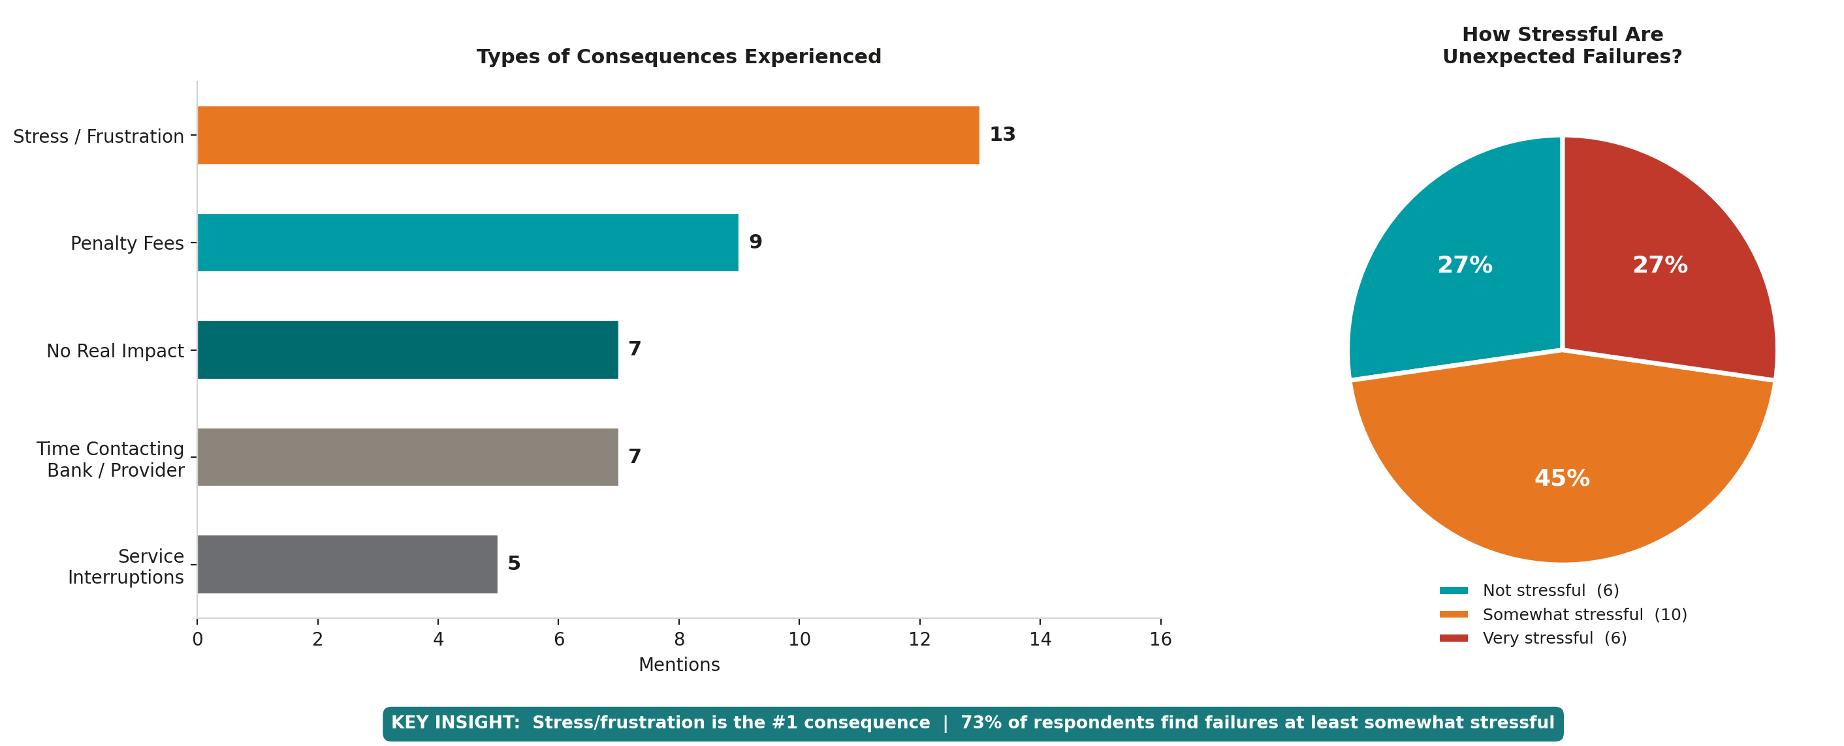
Consequences of Debit Order Failures

Slide 14
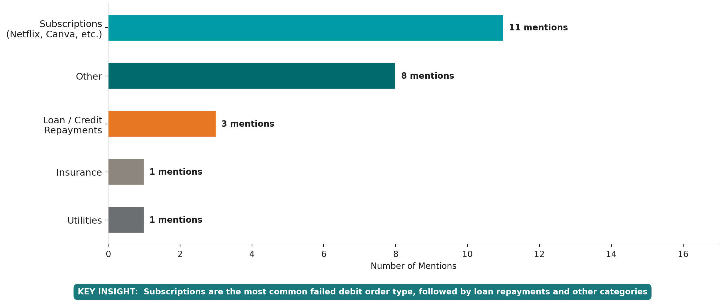
Categories of Debit Order Most Likely to Fail

Slide 15
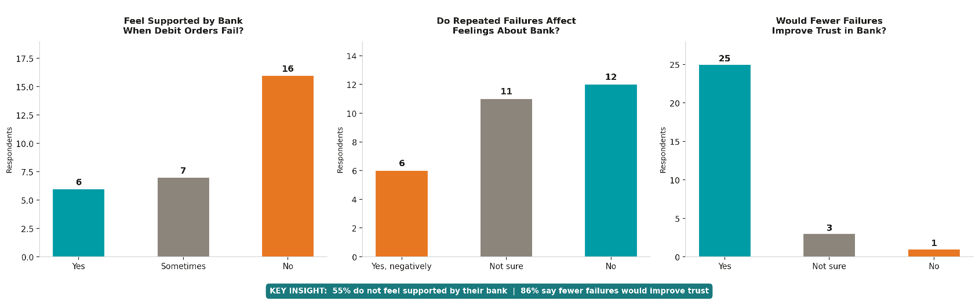
Satisfaction with Bank When Debit Orders Fail

Slide 16
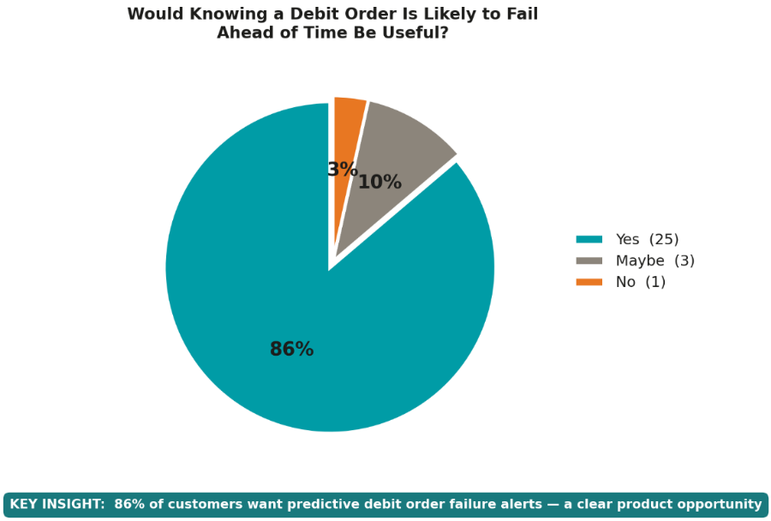
Demand for a Predictive Debit Order Service
KEY INSIGHT: 86%of respondents want predictive debit order failure alerts – a clear product opportunity

Slide 17
Solution
Introducing PaySure

Slide 18
PaySure = Predict → Protect → Optimise
PaySure is a predictive financial protection layer built inside FNB’s ecosystem.
It integrates:
nav»Money predictive cashflow modelling
inContact real-time notifications
Existing FNB credit facilities
Behavioural risk and affordability scoring
Instead of reacting to failed debit orders, PaySure:
Detects risk before failure
Distinguishes timing risk from genuine shortfall
Guides customers to the lowest-risk solution

Slide 19
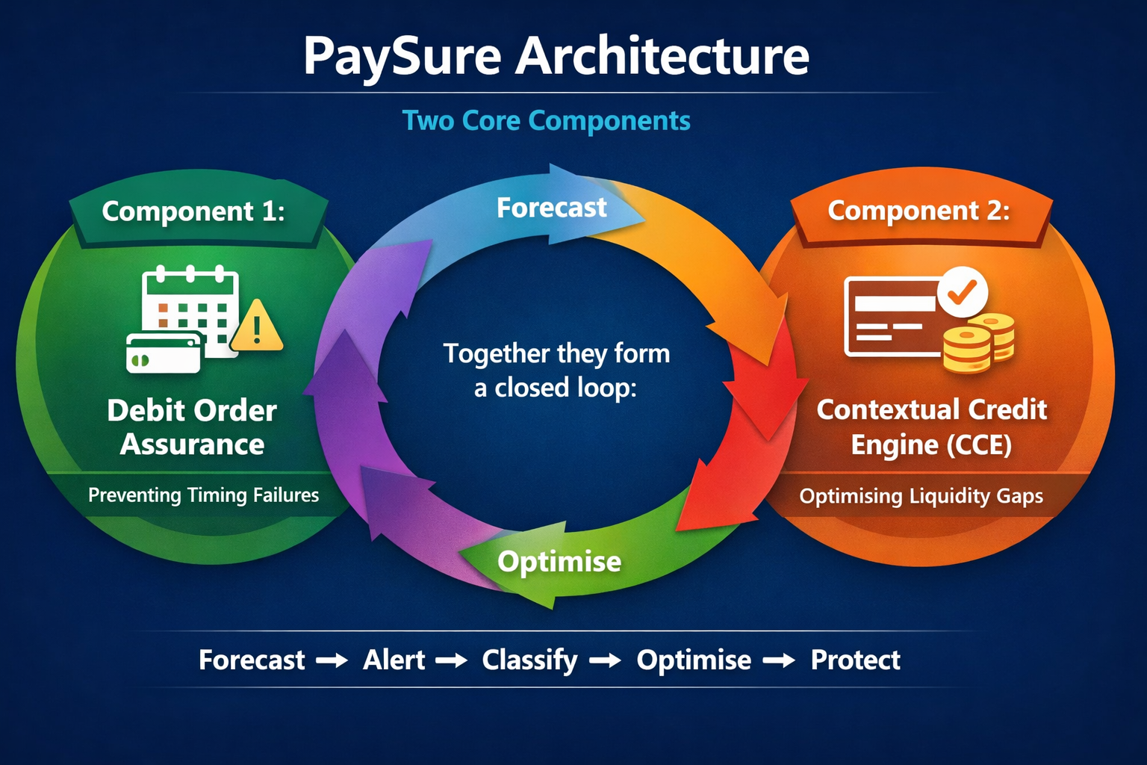
Two Core Components ​
Component 1: Debit Order Assurance Prevents failures caused by timing and visibility gaps.
Component 2: Contextual Credit Engine (CCE) Optimises credit guidance when genuine liquidity gaps exist.

Slide 20
Component 1 – Debit Order Assurance
What It Solves
Customers don’t know what debit orders are coming
They don’t see projected balance impact
They react after failure
What It Does
Shows upcoming debit obligations inside nav»Money
Sends pre-debit notifications (2–10 days prior)
Projects balance after debit
Alerts when shortfall risk is predicted
This addresses Payment Orchestration Risk.

Slide 21
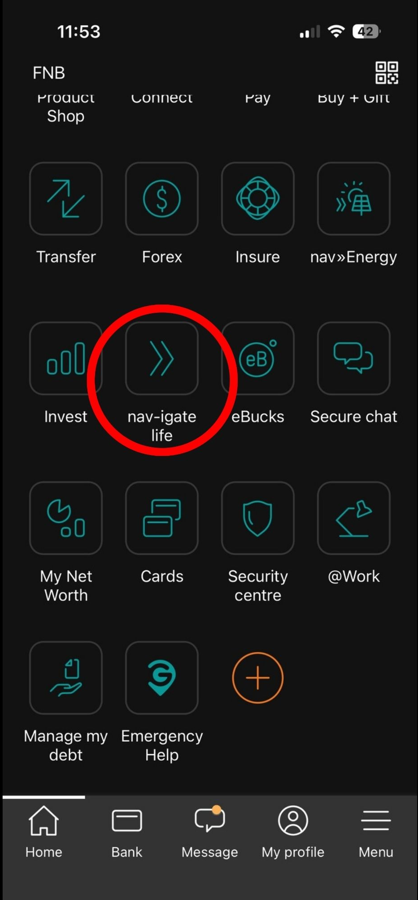
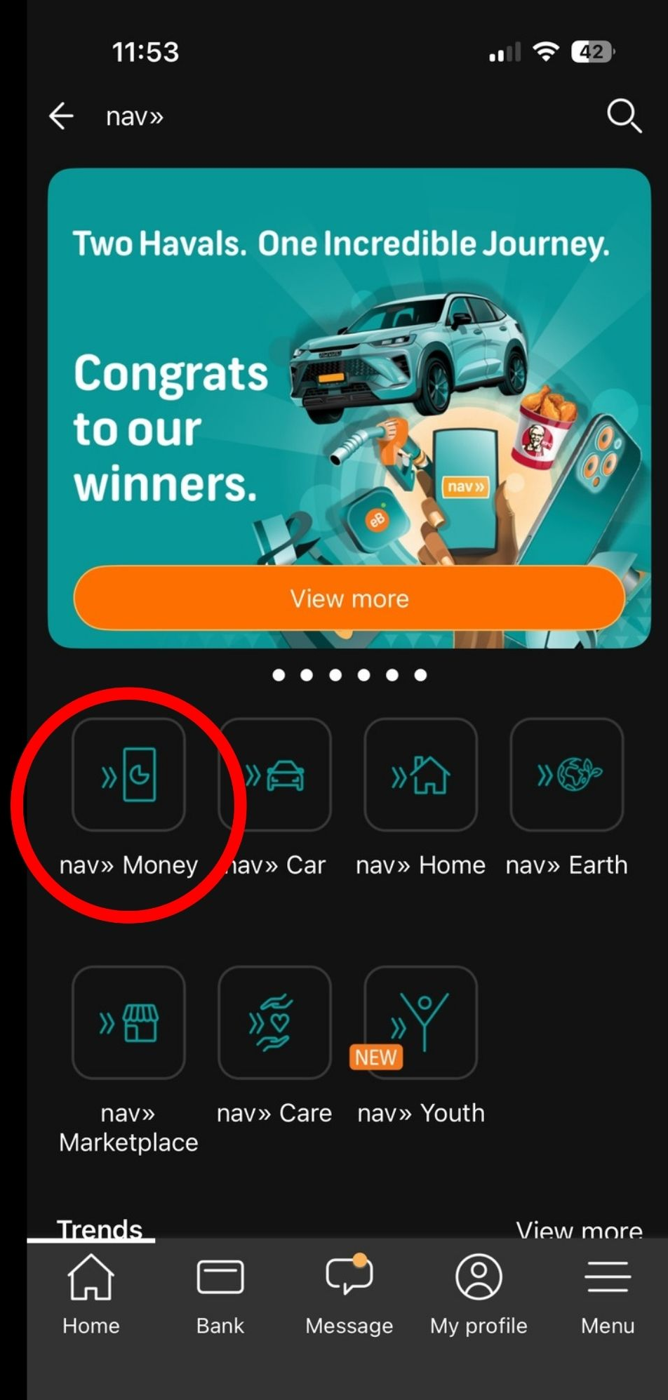
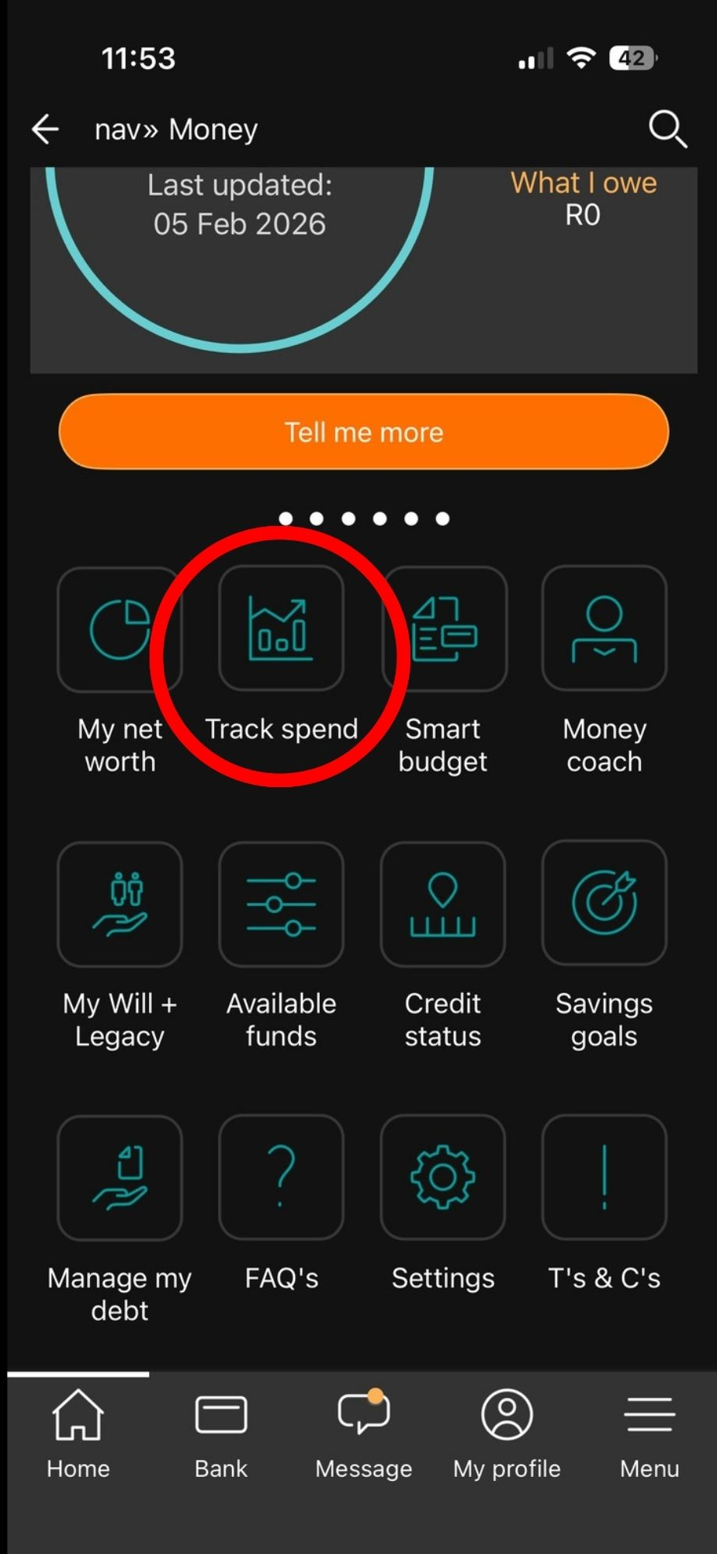
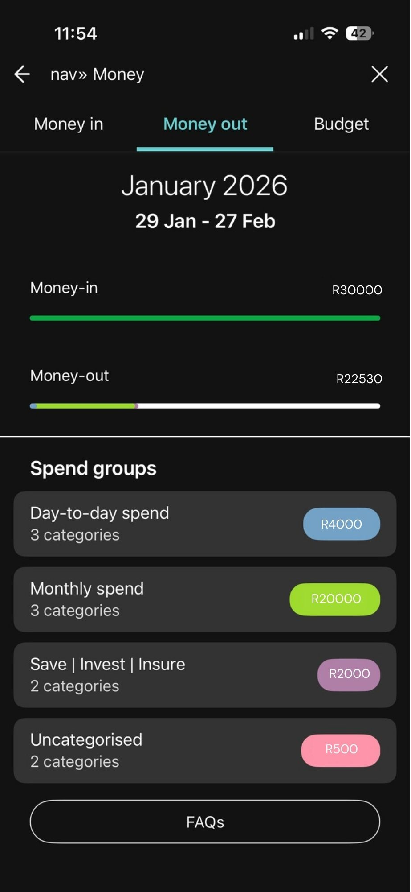
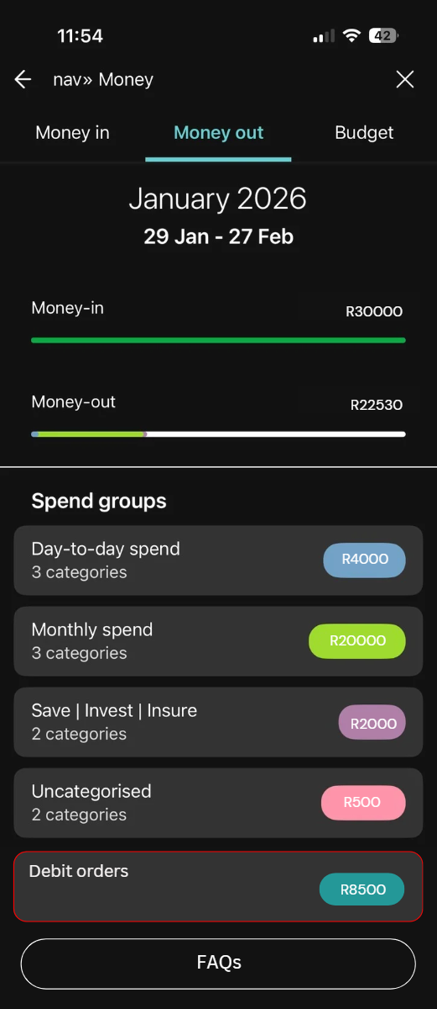
Nav » Money → Upcoming Debit Orders

Slide 22
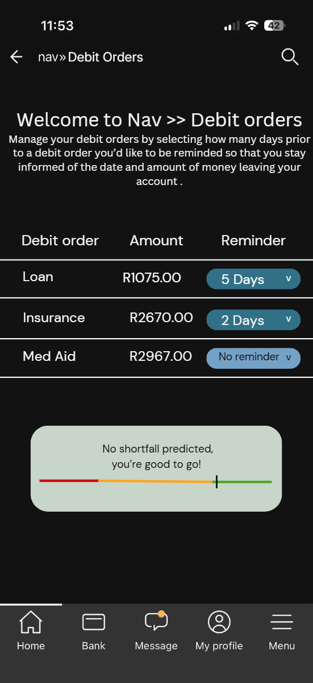
Customer can:
View all scheduled debit orders
See projected post-debit balance
Identify shortfall risk visually
Customise notification timing

Slide 23
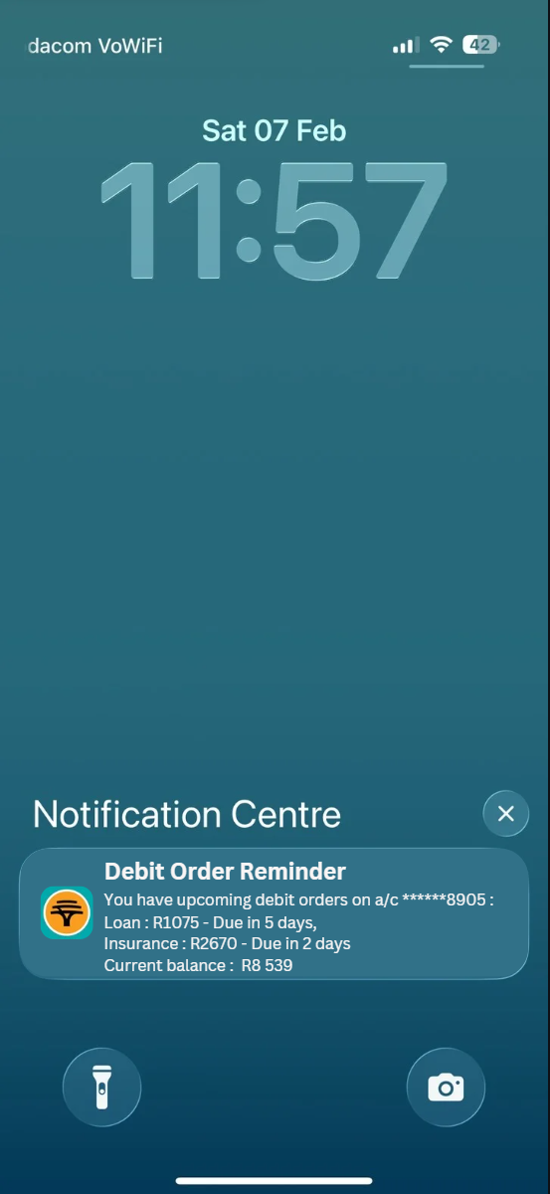
Smart Notifications via inContact/App
Notification preview
​
Account number
Debit order title, amount and when it is due
Current account balance

Slide 24
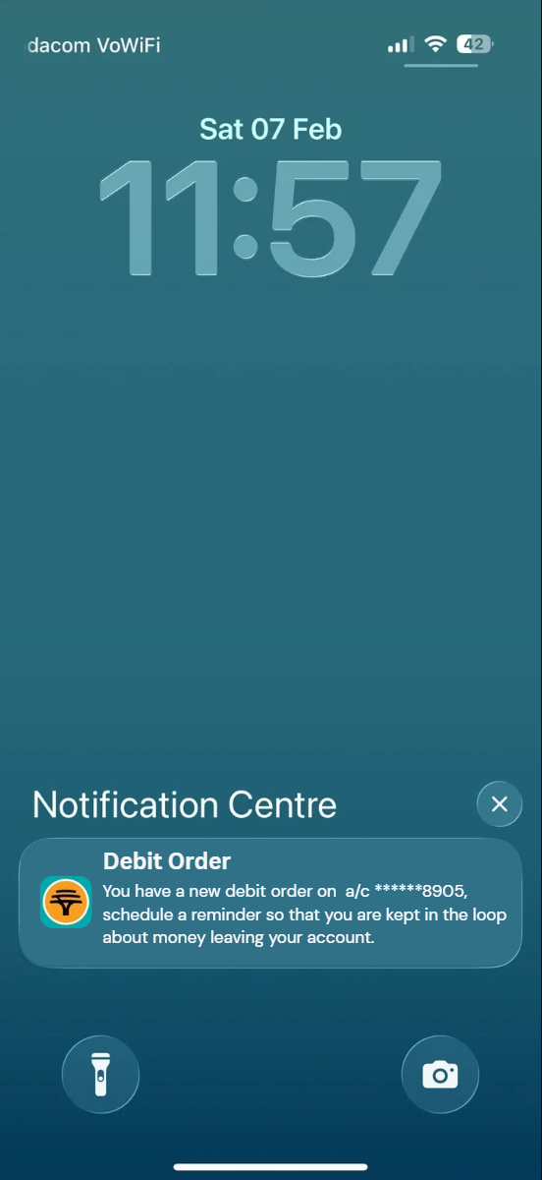
​
If new debit is authorised:
Customer is alerted immediately
Asked to schedule reminder
Gains visibility from day one
This closes the visibility gap entirely.

Slide 25
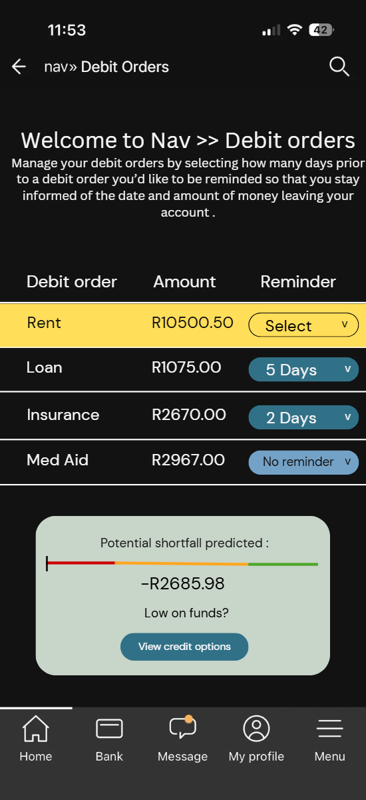
Walkthrough
New debit order is highlighted
New debit order required reminder to be scheduled
Potential shortfall of funds predicted due to new debit order
R2 685,98 shortfall post debit order payments

Slide 26
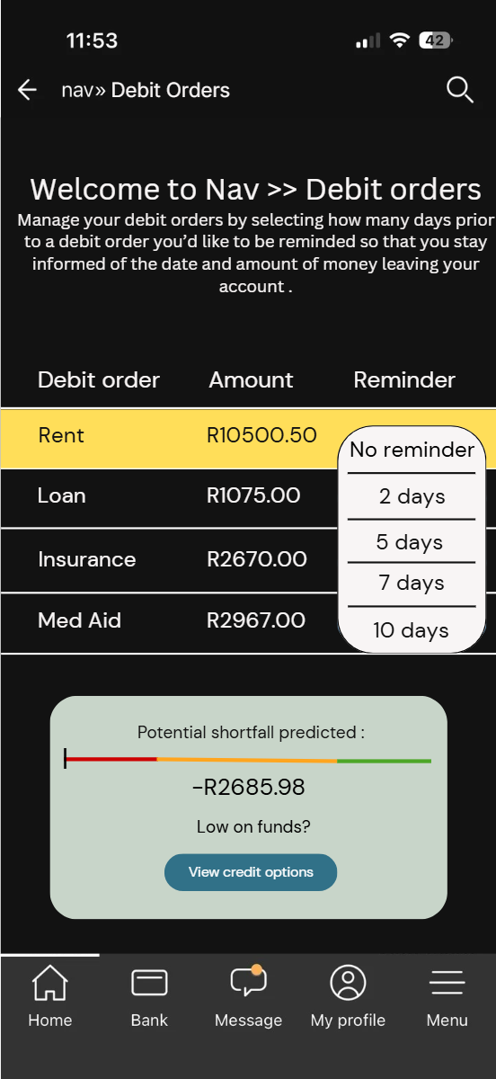
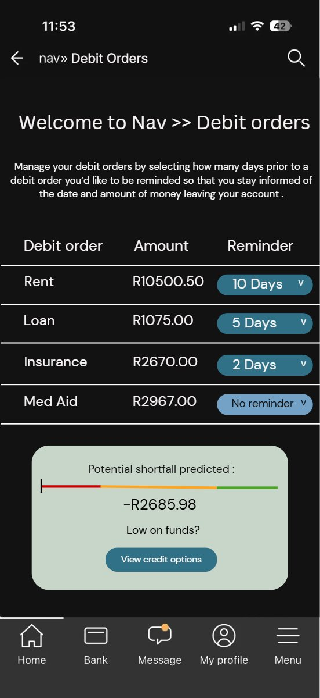
​
The customer may select a pre-debit order reminder based on personal preference
The customer may also opt to not be reminded

Slide 27
Component 2 – Contextual Credit Engine
When Funds Truly Don’t Exist
If liquidity risk is confirmed:
The system asks:
“What is the lowest-risk way to prevent this failure?”
Not:
“Do you qualify for a loan?”
CCE transforms credit from product push to contextual optimisation.
This addresses Short-Duration Liquidity Risk

Slide 28
How the CCE Thinks
Three-stage logic:
Event Classification
Timing risk? → No credit needed
Genuine shortfall? → Proceed
Repayment Certainty Index (RCI)
Measures short-horizon repayment confidence
Tiered (T1–T4)
Product Optimisation
Simulates overdraft, credit card, temp loan, salary advance
Calculates Risk-Adjusted Liquidity Cost (RALC)
Recommends lowest-risk option

Slide 29

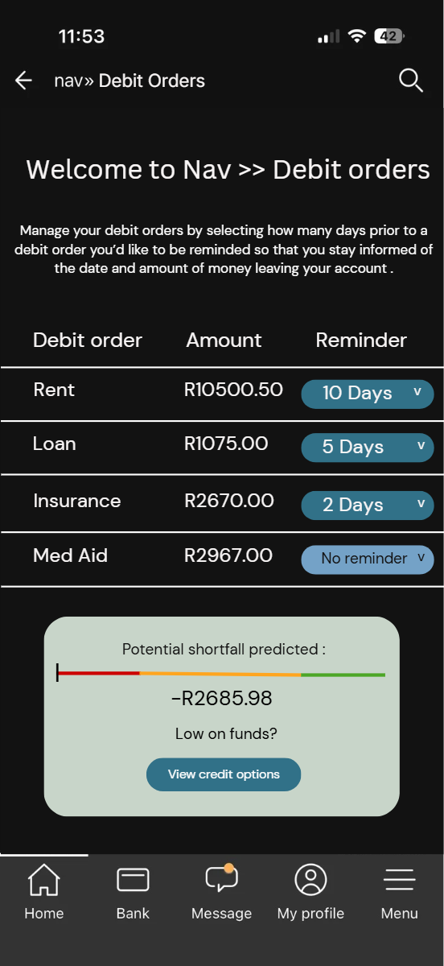
Walkthrough

Slide 30
Strategic Impact

Slide 31
Why this matters
PaySure reshapes debit-order economics.
Between Apr 2024 – Jan 2026:
233 million debit orders processed
19.54% failure rate
~12 million failures annually
Even a 1% improvement = massive impact.

Slide 32
Competitive and Strategic Landscape

Slide 33
Customers today want financial insight, not just information.
Bank​ | Prediction​ | Visibility​ | Proactivity​ | Key Gap​
FNB​ | ✓​ | △​ | △​ ​ | Lack a proactive element to its money management tool​
Standard Bank​ | △​ | ✓​ | △​ | Do not have predictive balance forecasting​
Discovery Bank​ | △​ | △​ | ✓​ | Do not integrate alerts into their budgeting engine nor have any balance forecasting
ABSA​ | ✗​ | △​ | ✗​ | Supports savings management, not budgeting with proactive or predictive elements
Nedbank​ | ✗​ | △​ | ?​ | No proactive or predictive elements​
Capitec​ | ✗​ | ✗​ | ✗​ | No money management tools​
KEY | STRONG CAPABILITY | PARTIAL CAPABILITY | NOT OFFERED | NOT KNOWN
 | ✓​ | △​ | ✗​ | ?​

Slide 34
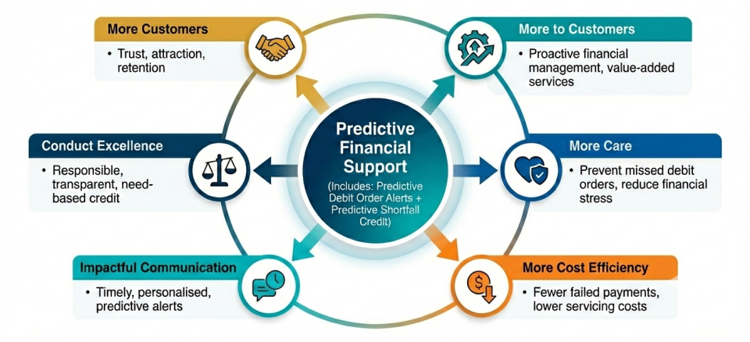
IDEAS LIKE THESE CONTINUE TO POSITION FNB AS A FORERUNNER IN PERSONALISED BANKING

Slide 35
Conclusion
Customer benefits:
Early visibility of upcoming debit orders and potential shortfalls.
Reduced penalty fees and failed payments.
Improved financial control and planning.
Responsible, contextual financial support.
Bank benefits:
Increased debit order success rates.
Reduced disputes and operational costs.
Improved customer satisfaction, trust and retention.
Stronger revenue protection and liquidity stability.

Slide 36
Conclusion
Final strategic recommendation:
Pilot PaySure within the FNB digital ecosystem.
Leverage predictive insights to prevent payment failures.
Position FNB as a leader in predictive financial intelligence.

Slide 37

THANK YOU.
QUESTIONS?

Slide 38
CEO PROJECT 2026
GROUP 22

